Slide 1
Building RAG System with Agentic AI
Smart Document Question Answering using RAG and Agentic AI (Streamlit + Google Colab)

Slide 2
Introduction
The "Smart Document QA" project is designed to intelligently answer user queries from historical documents using advanced Retrieval-Augmented Generation (RAG) techniques. This system enhances traditional QA by combining a vector-based retriever and a transformer-based language model (LLM). Built with LangChain, FAISS, and Streamlit, and powered by HuggingFace transformers, this system supports scalable, cost-effective, and intelligent interaction with large textual data—especially focused on Indian History documents.

Slide 3
Deployment Summary
Backend: LangChain + FAISS + HuggingFace
LLM: flan-t5-small
Frontend: Streamlit Web UI
Platform: Google Colab (development) + Streamlit Cloud (deployment)
Storage: FAISS VectorStore for document embeddings

Slide 4
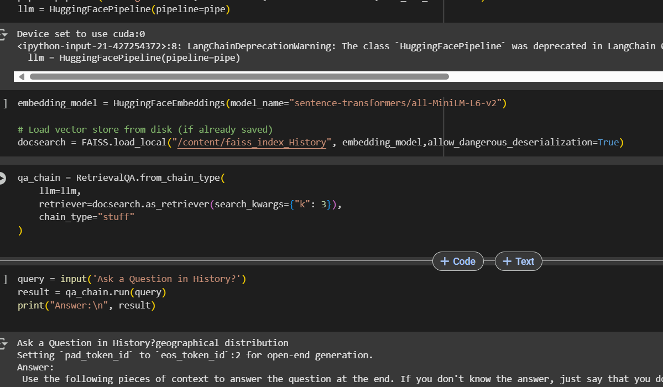
Agentic RAG Design (Next Enhancement Plan)
The system is designed for modular upgrades:
Retriever Agent: Fetches relevant chunks from documents using FAISS.
QA Agent: Uses custom prompt + LLM to generate answers.
Verifier Agent (Planned): Post-processes and verifies answer quality.
LLM Flexibility: Support for local inference (Colab) and lightweight deployment (Streamlit).

Slide 5
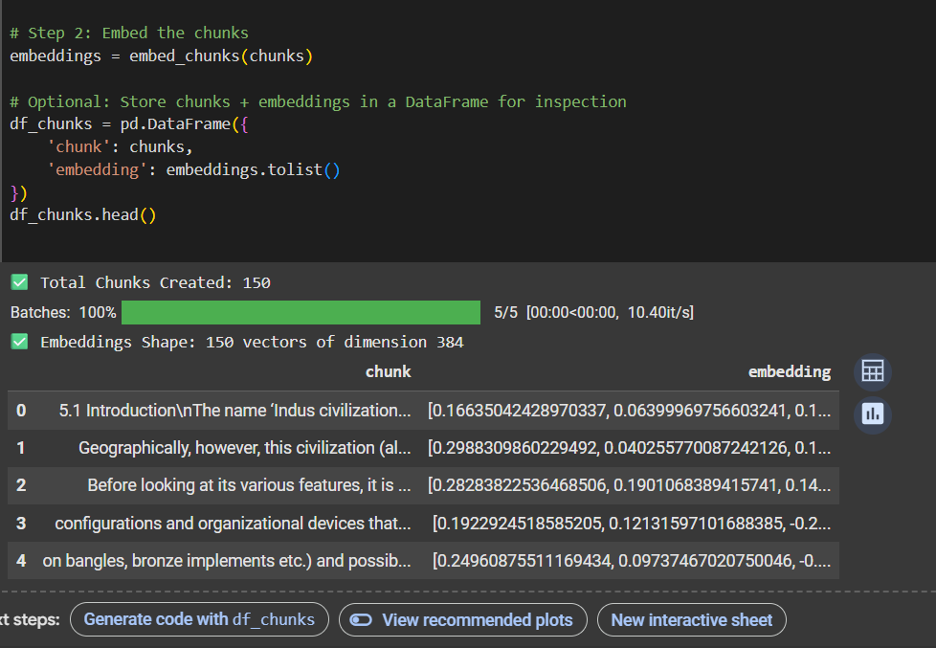
Chunks and embeddings

Slide 6
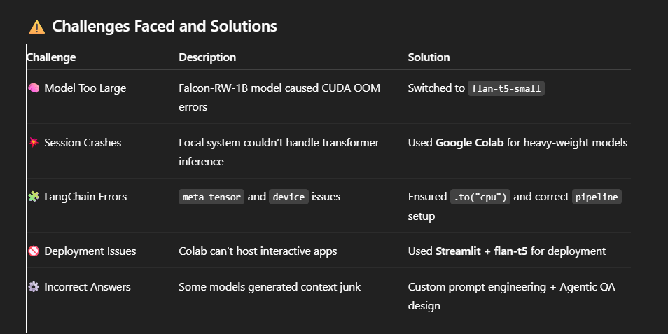
Challenges

Slide 7
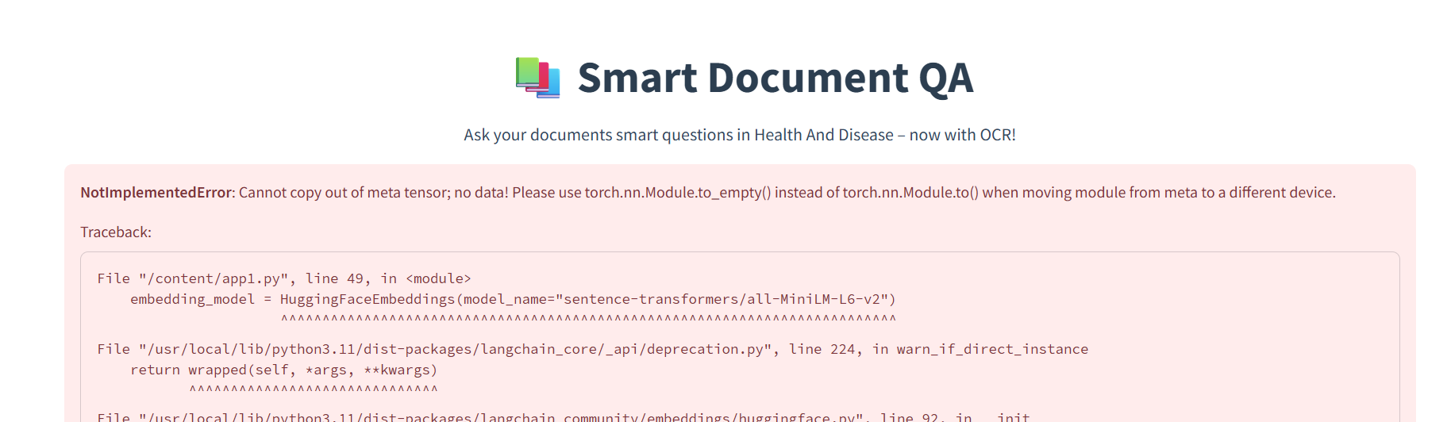
While changing Fiass vector and araise for some documents

Slide 8
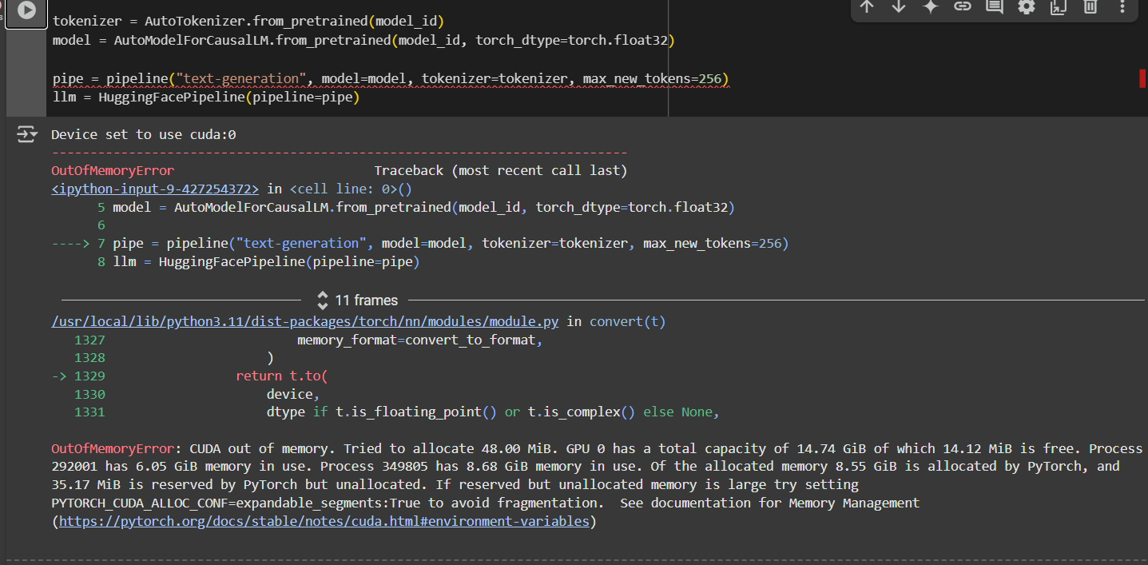
Memory issue I have face a lot

Slide 9
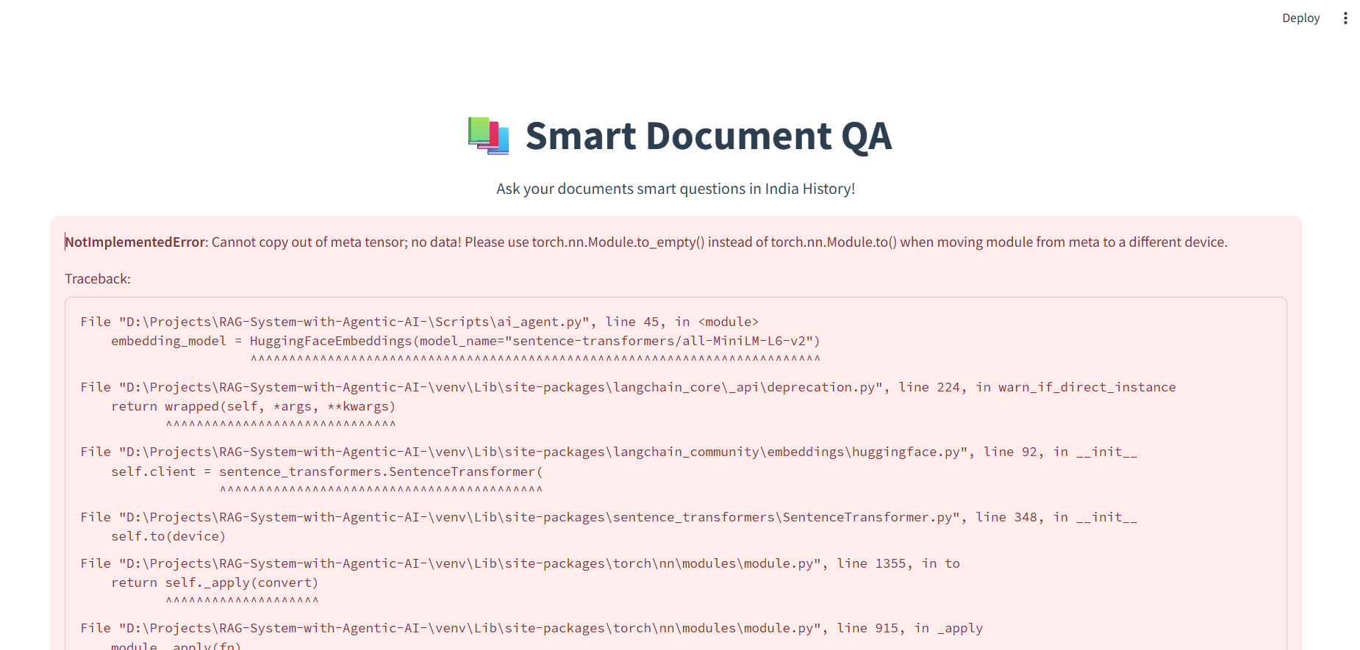
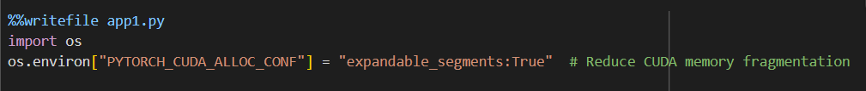
This error clear using this parameter

Slide 10
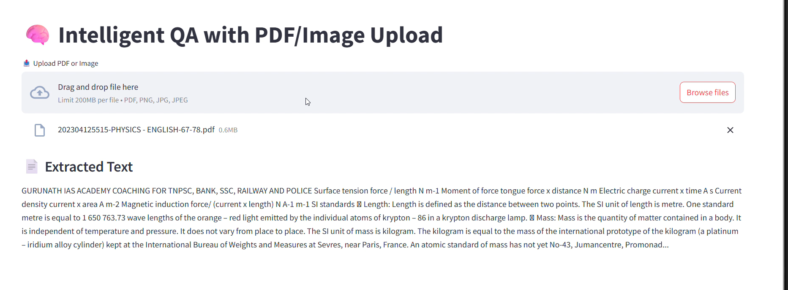
EXTRACT TEXT FROM PDF (PDFPLUMBER)

Slide 11
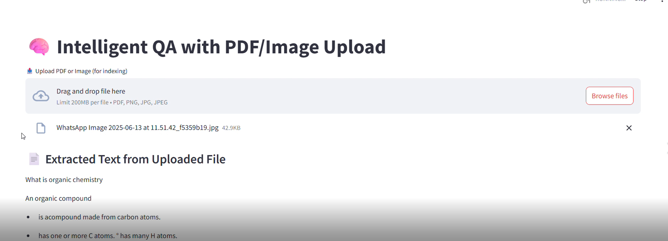
EXTRACT TEXT FROM IMAGE(PYTESSARACT)

Slide 12
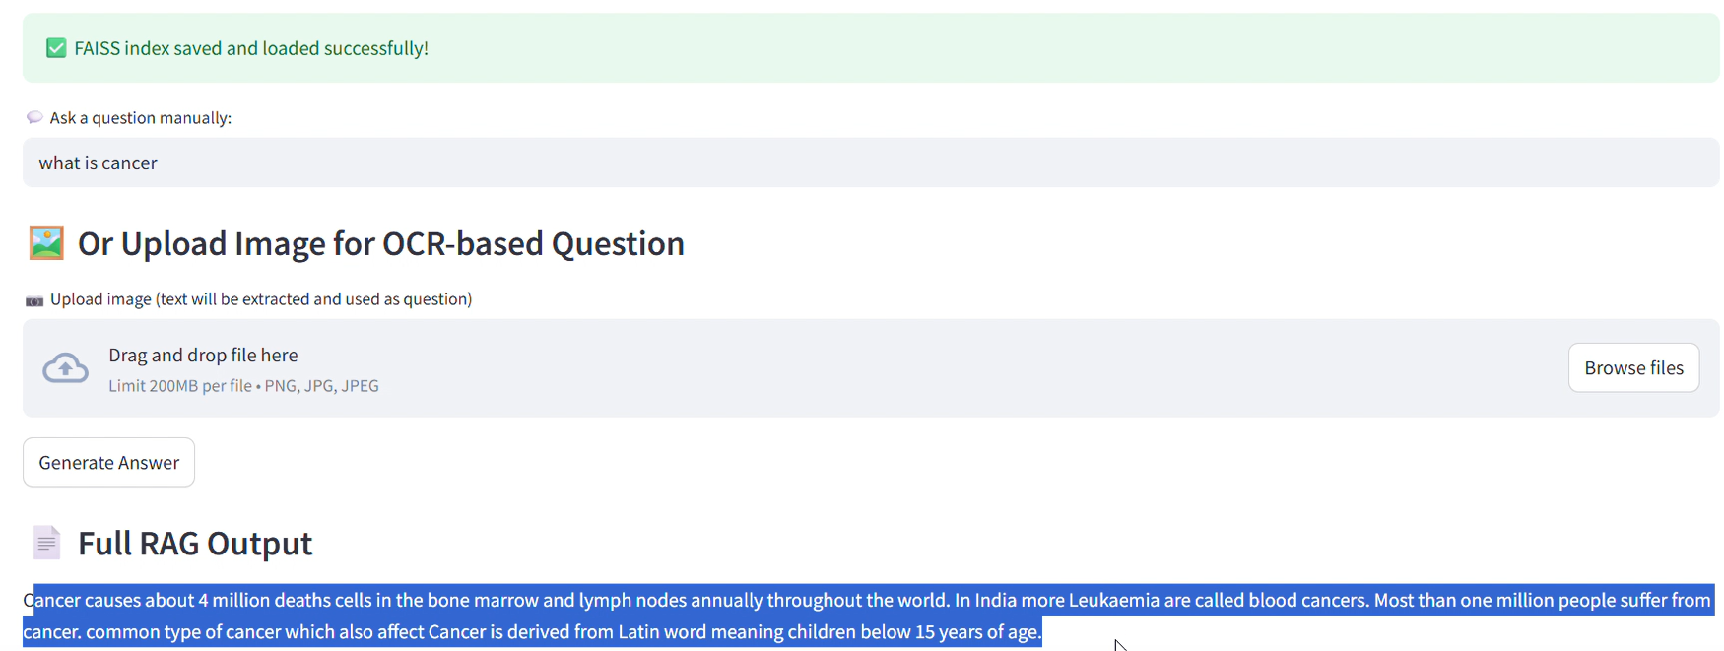
GENERATE ANSWER WITH TEXT QUERY

Slide 13
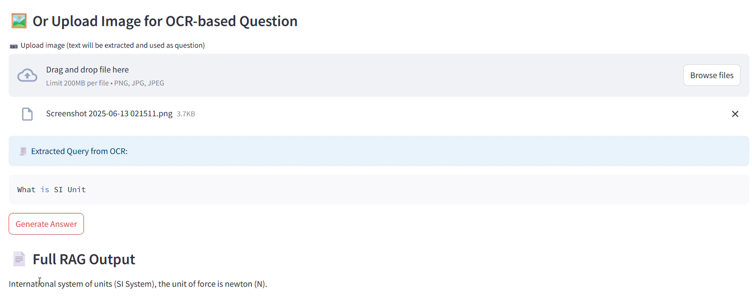
GET ANSWER FOR IMAGE USING OCR

Slide 14
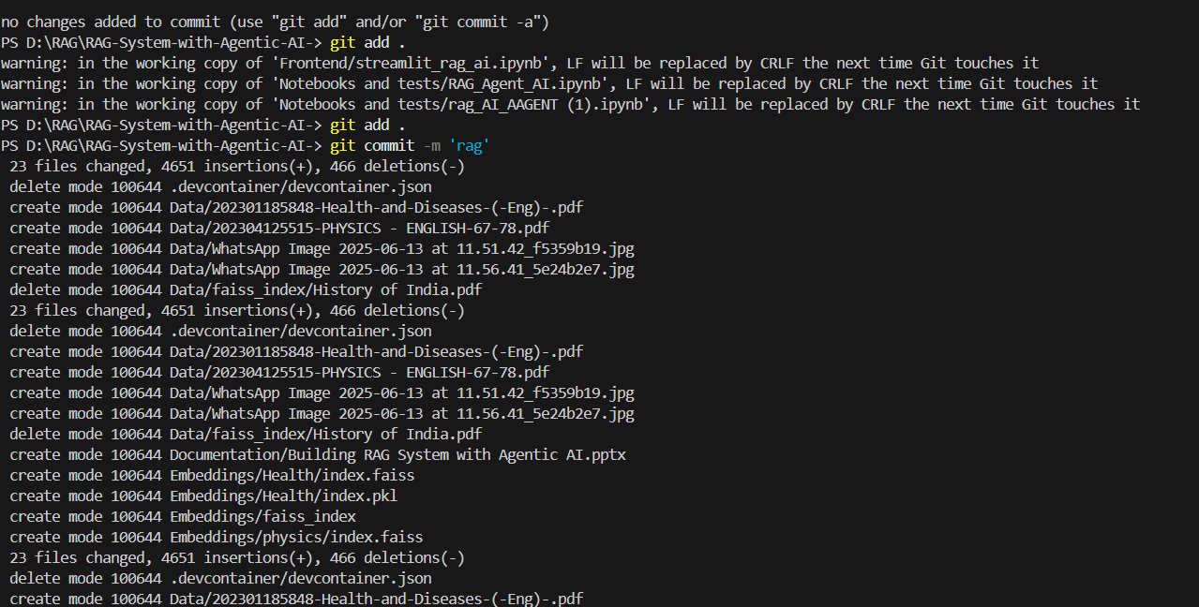
Git Push

Slide 15
Conclusion
This Smart QA system demonstrates a low-cost, efficient, and scalable solution for businesses to offer intelligent document interaction. With modular components and agentic design, this project supports:
Client-side accessibility via a clean Streamlit UI
Low compute cost, making it ideal for startups and SMEs
Custom document domain adaptation (history, medical, legal, etc.)
Future extensibility using LangGraph for autonomous agents
The result is a powerful, memory-efficient, and deployable RAG system that is production-ready and can transform document access for businesses.

